Slide 1
CAPSTONE PROJECT
PRESENTED BY AARTHISHWARI.B 510421214001
B.TECH BIOTECHNOLOGY
ARUNAI ENGINEERING COLLEGE
3/21/2024 Annual Review

Slide 2
PROJECT TITLE
HOTEL BOOKING ANALYSIS
3/21/2024 Annual Review

Slide 3


AGEND
A
PROBLEM STATEMENT
PROJECT OVERVIEW
WHO ARE THE END USERS
YOUR SOLUTIONS AND ITS VALUE PROPOSITION
THE WOW IN YOUR SOLUTION
MODELLING
RESULTS
3/21/2024 Annual Review

Slide 4

PROBLEM STATEMENT
Have you ever wondered when the best time of year to book a hotel room is? Or the optimal length of stay in order to get the best daily rate? What if you wanted to predict whether or not a hotel was likely to receive a disproportionately high number of special requests? This hotel booking dataset can help you explore those questions! This data set contains booking information for a city hotel and a resort hotel, and includes information such as when the booking was made, length of stay, the number of adults, children, and/or babies, and the number of available parking spaces, among other things. All personally identifying information has been removed from the data. Explore and analyse the data to discover important factors that govern the bookings.
3/21/2024 Annual Review

Slide 5















PROJECT OVERVIEW
The primary objective of this project is to , specifically focusing on cancellations and their underlying patterns. By understanding these patterns, we can suggest measures that hotel owners can implement to .
Here are the key points covered in this analysis:
3/21/2024 Annual Review

Slide 6















WHO ARE THE END USERS?
In the context of
, the
typically include:
3/21/2024 Annual Review

Slide 7





















YOUR SOLUTIONAND ITS VALUE PROPOSITION
.
:
Our comprehensive analysis provides actionable insights for hotel owners, managers, and revenue teams.
We focus on understanding cancellation patterns, pricing strategies, and guest preferences.
:
:
In summary, our solution empowers stakeholders with data-driven decisions, leading to improved revenue, guest satisfaction, and operational efficiency.
3/21/2024 Annual Review

Slide 8








THE WOW IN YOUR SOLUTION
Let’s explore the solution:
in our hotel booking analysis
:
Our solution goes beyond basic analysis by predicting individual guest preferences.
By analyzing historical data, we can recommend personalized experiences for each guest.
Imagine a guest receiving a room upgrade or a personalized welcome package based on their past behavior.
:
Our algorithms adjust room rates in real time based on demand, seasonality, and other factors.
Guests benefit from competitive prices, while hotels maximize revenue.
Picture a guest booking a room at the perfect price, tailored to their booking time and length of stay.
3/21/2024 Annual Review
8

Slide 9
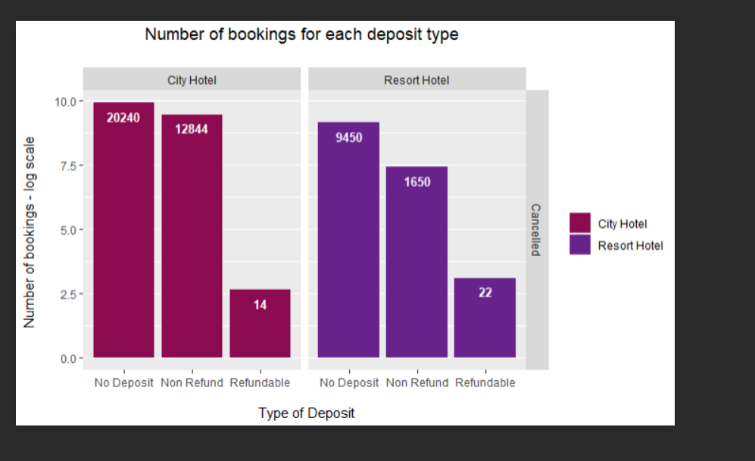
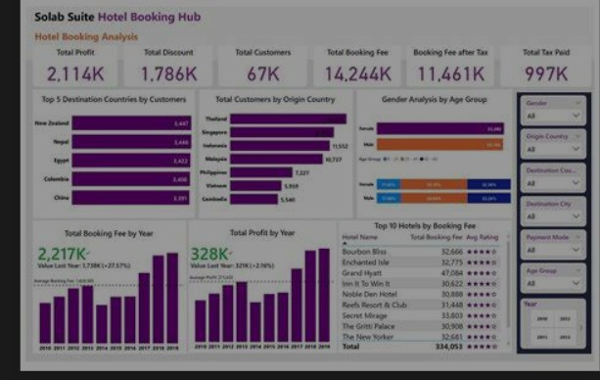
MODELLIN
G
Teams cam add wireframes
3/21/2024 A nual Review
9
n

Slide 10









RESULT S
Let’s delve into the results of hotel booking analysis based on the available data. Here are some key insights:
:
Remember that these insights can inform decision-making and help hotel owners enhance revenue and guest satisfaction
Demo
L3/i2n1/k2024 A nual Review
n
10

